Slide 1

New PopUpStore
Israel Sanchez - Ironhack

Slide 2
Where to open the PopUpStore?
A furniture Retailer wants to be closer the customers in the big city centers. They have decided to be open a bunch of PopupStores as a leap of faith to validate the assumption that the people will buy their furniture’s in the city centers.
The steering group has contacted to the Data Team for helping them to resolve the problem.
As a Data analyst I was asked to analyze the current real estate market in Madrid to provide some insights about the location.

Slide 3
Challenges
Normalizing the dictionaries inside of the json files.
Lack of ability to apply, in a proper way, the techniques seen previous weeks.

Slide 4
Process
Select one of the top real estate web sites in Madrid: URL: www.fotocasa.es
Design and preparation of the projects.
Web Scraping all rent and sale apartments in Madrid center.
Clean the data.
Import the data to MySQL Workbench.
Analyze the data.
The insights
Update the Github repo

Slide 5
Design and preparation of the project:
I have used Miro to create a visualization of the data I need to get from website. Here the Miro link: https://miro.com/app/board/o9J_lT6lKyU=/
I have used Trello as a productive tool to register the requirements needed to the project. https://trello.com/b/jU4yORwC

Slide 6
Web Scrapping:
After the analysis www.fotocasa.es I have seen that the website is API based.
Check if the request to the site web is allowed (get 200).
Find the right headers of the site.
Create a function to iterate through the different pages and recollect all the data in two json files. One for selling apartments and another for renting apartments. I've got around 18000 rows and 58 columns of selling apartments and 2300 rows and 58 columns of renting apartments.

Slide 7
Clean the data:
Get rid of the duplicated rows. I have discovered that half of the flats for selling where duplicated. So, I finalized with 9000 rows of selling flats.
The json files were dictionaries oriented and I have normalized all the dictionaries to extract all the values related to the Price, Squared meters, Rooms, Location, terrace, parking, elevator, description of the announce and the links of the flat pictures.
I have dropped all the unnecessary columns.
I have searched the outliers through boxplot, IQR and Z-Score.
I have removed the extreme values.
I have created a new column with the price per squared meter.
Same process for the Rent apartments.
Export the files to CSV.

Slide 8
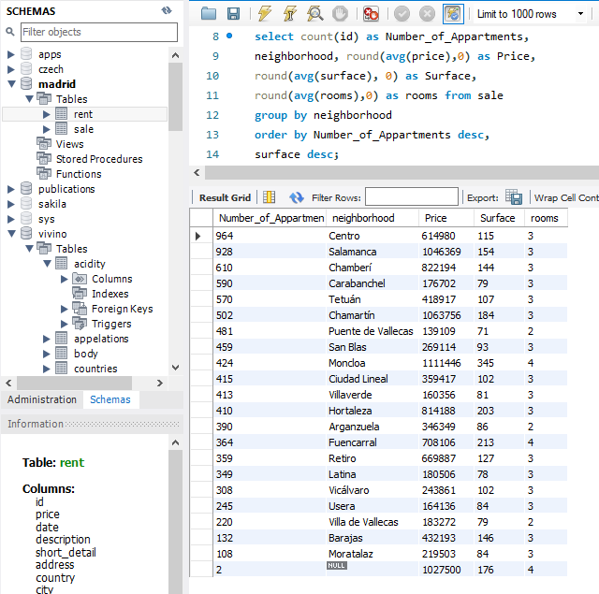
Import to MySQL
Create a new schema. "Madrid"
Import table sale
Import table rent.
I have prepared some queries in MySQL Workbench to be used in the analysis of the data.

Slide 9
Analyze the data.
I have imported to Jupyter notebook the tables from MySQL Workbench and I've filtered and group them base on Qty of apartments, neighborhood, price, surface, rooms and percentage of apartments per districts.

Slide 10
Learnings
WebScraping
Normalizing json files
Cleanning Data
Extreme Values
Outliers
Database creation
Table import.
Filtering
Grouping

Slide 11
If I were to start from the scratch
I would try to make my code more efficient and avoid repeating myself.

Slide 12
Improvements
Creating visualizations heatmaps with the locations of the appartments.
Focus on functions creation to automatize the steps for every dictionary of json the files

Slide 13
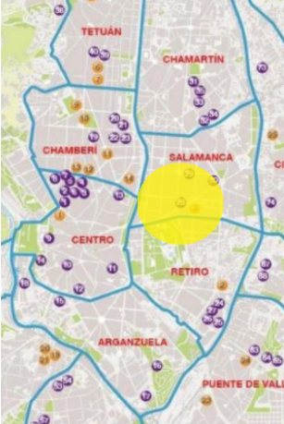
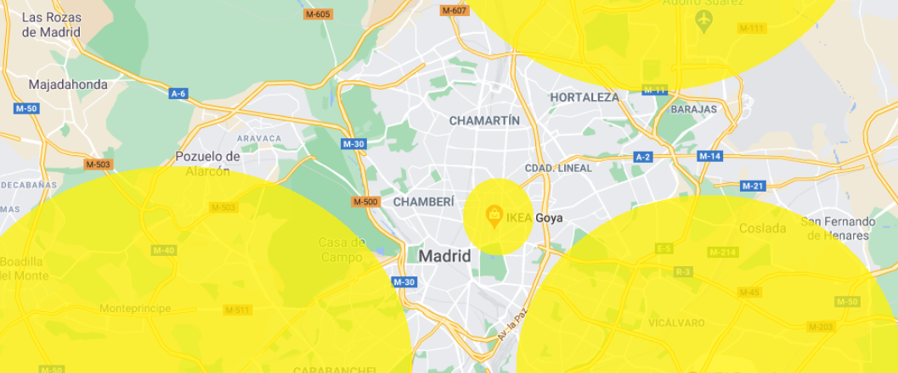
Current locations for the stores

Slide 14
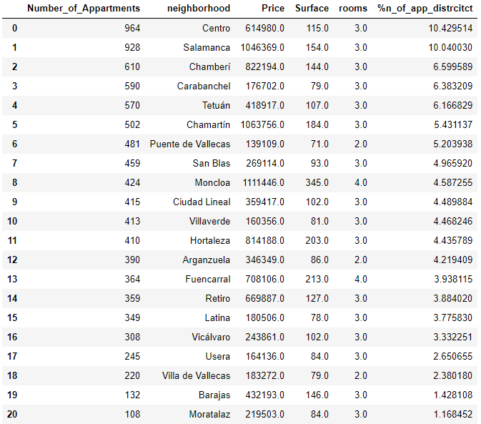
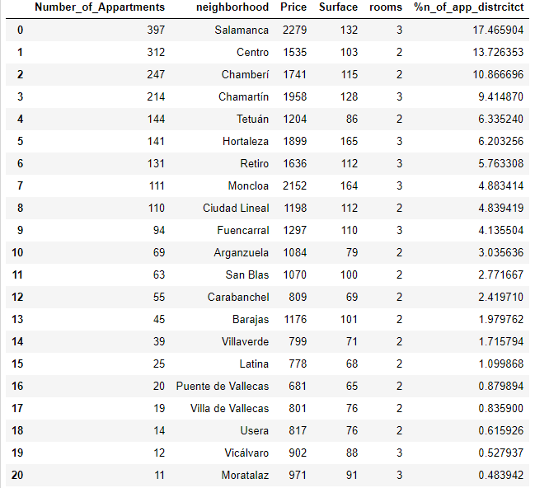
Tables for getting the insights

Slide 15
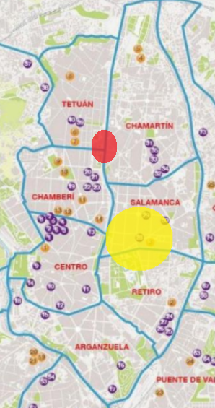
The insights:
The neighborhoods with the highest number of apartments on sale and renting are Center (sol) and Salamanca’s neighborhoods. The business competition is in the area. The price per meter is expensive in both locations, the hypothesis is that these areas have not a regular turnover. This hypothesis needs to be validated with other kind of data.
Chamberi, Tetuan and Chamartín are adjacent districts. Together have the 18.03% selling flats and 26,6 % of reting flats of the real estate current Market. According to the analysis. A location between the three districts will be suitable.
Carabanchel and Puente de Vallecas are two areas with potential but the average squared meters and the number of rooms are smaller than the same values in the above districts.

Slide 16
Github Repo
NewPoPUpStore

